Slide 1

Note: The data and information in this document is reflective of a hypothetical situation and client. This document is to be used for KPMG Virtual Internship purposes only.
Sprocket Central Pty Ltd
Data analytics approach
Analytics Department- Junior Consultant

Slide 2
Note: The data and information in this document is reflective of a hypothetical situation and client. This document is to be used for KPMG Virtual Internship purposes only.
Agenda
Introduction
Data Exploration
Model Development
Interpretation

Slide 3
Note: The data and information in this document is reflective of a hypothetical situation and client. This document is to be used for KPMG Virtual Internship purposes only.
Introduction
Sprocket Central Pty Ltd Market Expansion Case
Sprocket marketing teams desires to expand their customer base.
Based on the 1000 new customer dataset provided. The approach will engage in analysis of the existing customer demographic, customer address and transactions data set to aid the selection of target customers.
Place any supporting images, graphs, data or extra text here.

Slide 4
Note: The data and information in this document is reflective of a hypothetical situation and client. This document is to be used for KPMG Virtual Internship purposes only.
Data Exploration
SQL Sever and Excel were used for the data exploration, cleaning and transformation.
Customer_id is a primary and foreign key which will be used to link datasets
DATA FINDINGS SUMMARY
Data Sets | Duplication | Inconsistencies | Data Type Inaccuracy | Blanks | Necessary Colums Created
Customer Demographics | NIL | Gender Column: F and Femal, M and Male | NIL | Brand of a purchase and Job Title Columns have some blanks | Age
Customer Address | NIL | State Column: New South Wales, NSW and Victoria, VIC | DOB | NIL | NIL
Transactions | Customer ID but this is normal | NIL |  | NIL | Profit, Recency
New Customer List | NIL | NIL | Past_3_years_bike_related_purchases, DOB and Post Code Columns in text format | NIL | Age

Slide 5
Note: The data and information in this document is reflective of a hypothetical situation and client. This document is to be used for KPMG Virtual Internship purposes only.
Model Development
RFM Approach is used for determining the Best Customers
RFM is a Recency, Frequency and Monetary Approach that allows marketers target specific clusters of customers
‘Platnium’ was awarded to customers with the Highest RFM scores identified as the ‘Best customers’
The characteristics of the 792 Platnium Customers were further analysed

Slide 6
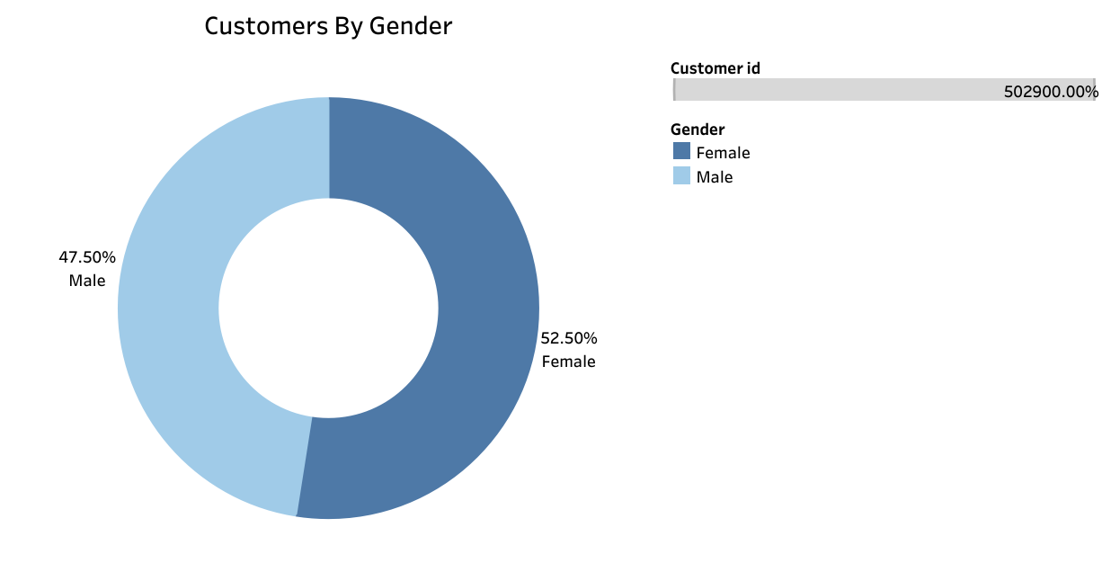
Note: The data and information in this document is reflective of a hypothetical situation and client. This document is to be used for KPMG Virtual Internship purposes only.
Model Development: Customers Analysis
Analysis by Gender shows that Women account for the highest share of the Best Customers
Features of Best customers are
analysed by;
Gender
State
Age
Wealth Segment
Job Industry
Customers By Gender

Slide 7
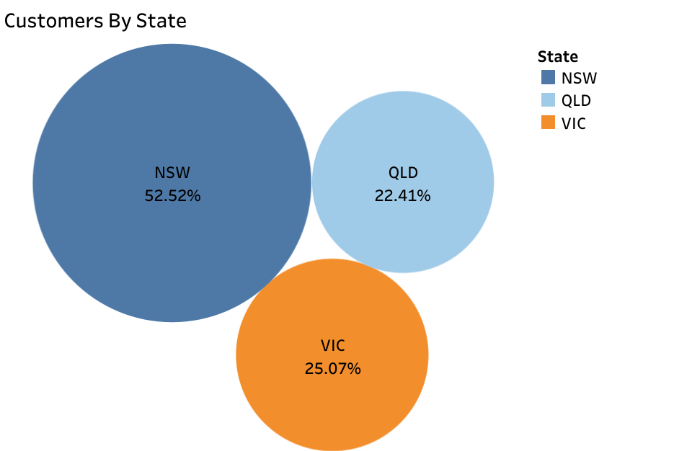
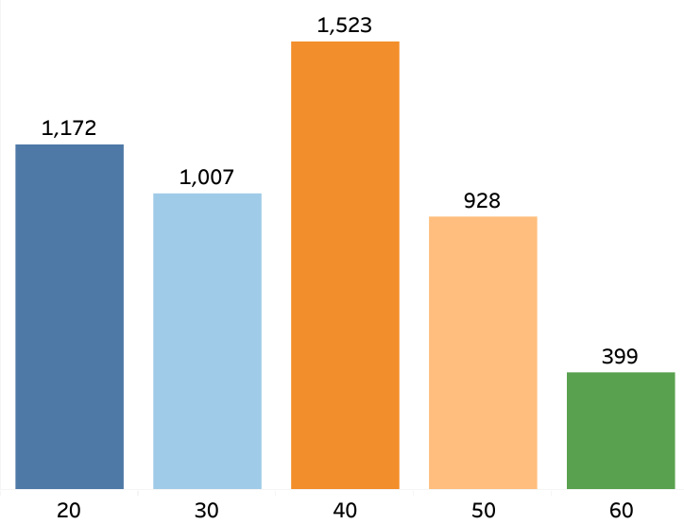
Note: The data and information in this document is reflective of a hypothetical situation and client. This document is to be used for KPMG Virtual Internship purposes only.
Model Development: Customers By State and Age Category
New South Wales accounts for the highest population of loyal customers
Customers in their 40s are regarded as the most loyal
Customers By State
Customers By Age Category

Slide 8
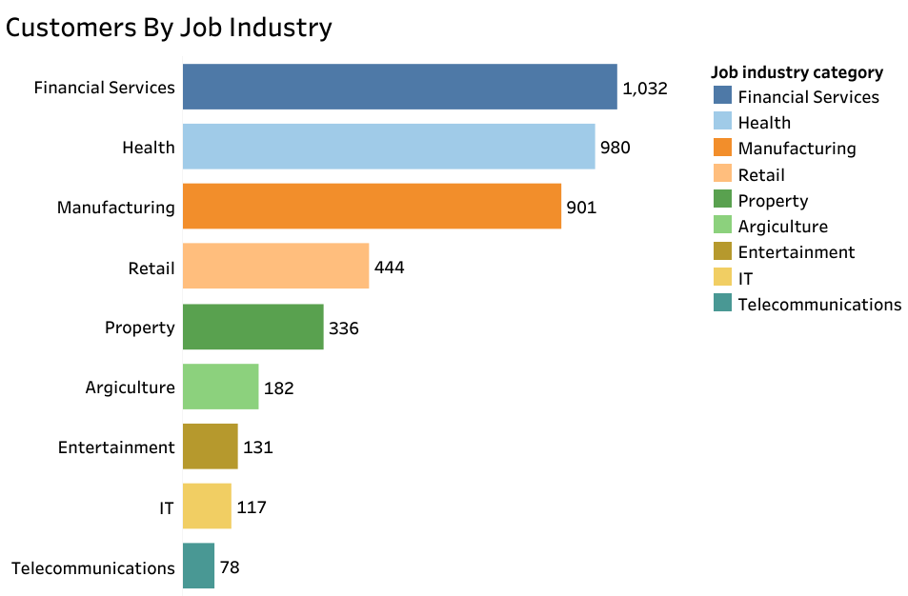
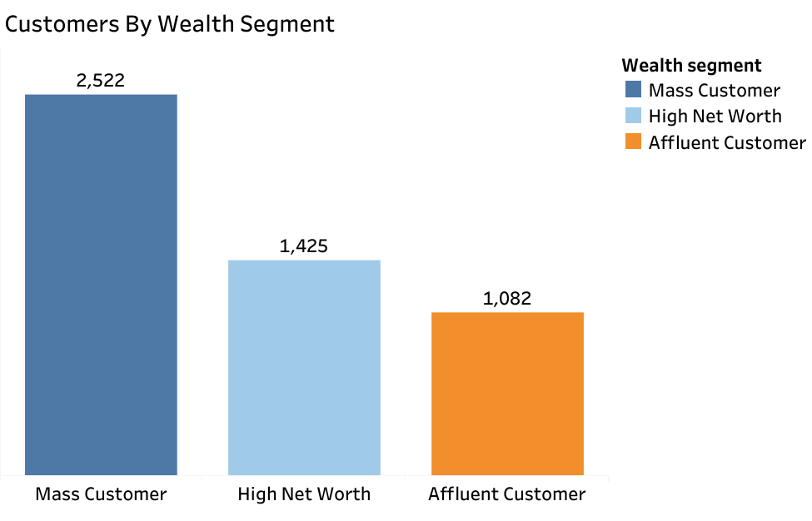
Note: The data and information in this document is reflective of a hypothetical situation and client. This document is to be used for KPMG Virtual Internship purposes only.
Model Development: Customers By Wealth Segment & Job Industry
Best Customers are from the Mass Wealth Segment .
Best Customers work in the Financial Services, Health and Manufacturing Industries.
Customers By Job Industry
Customers By Wealth Segment

Slide 9
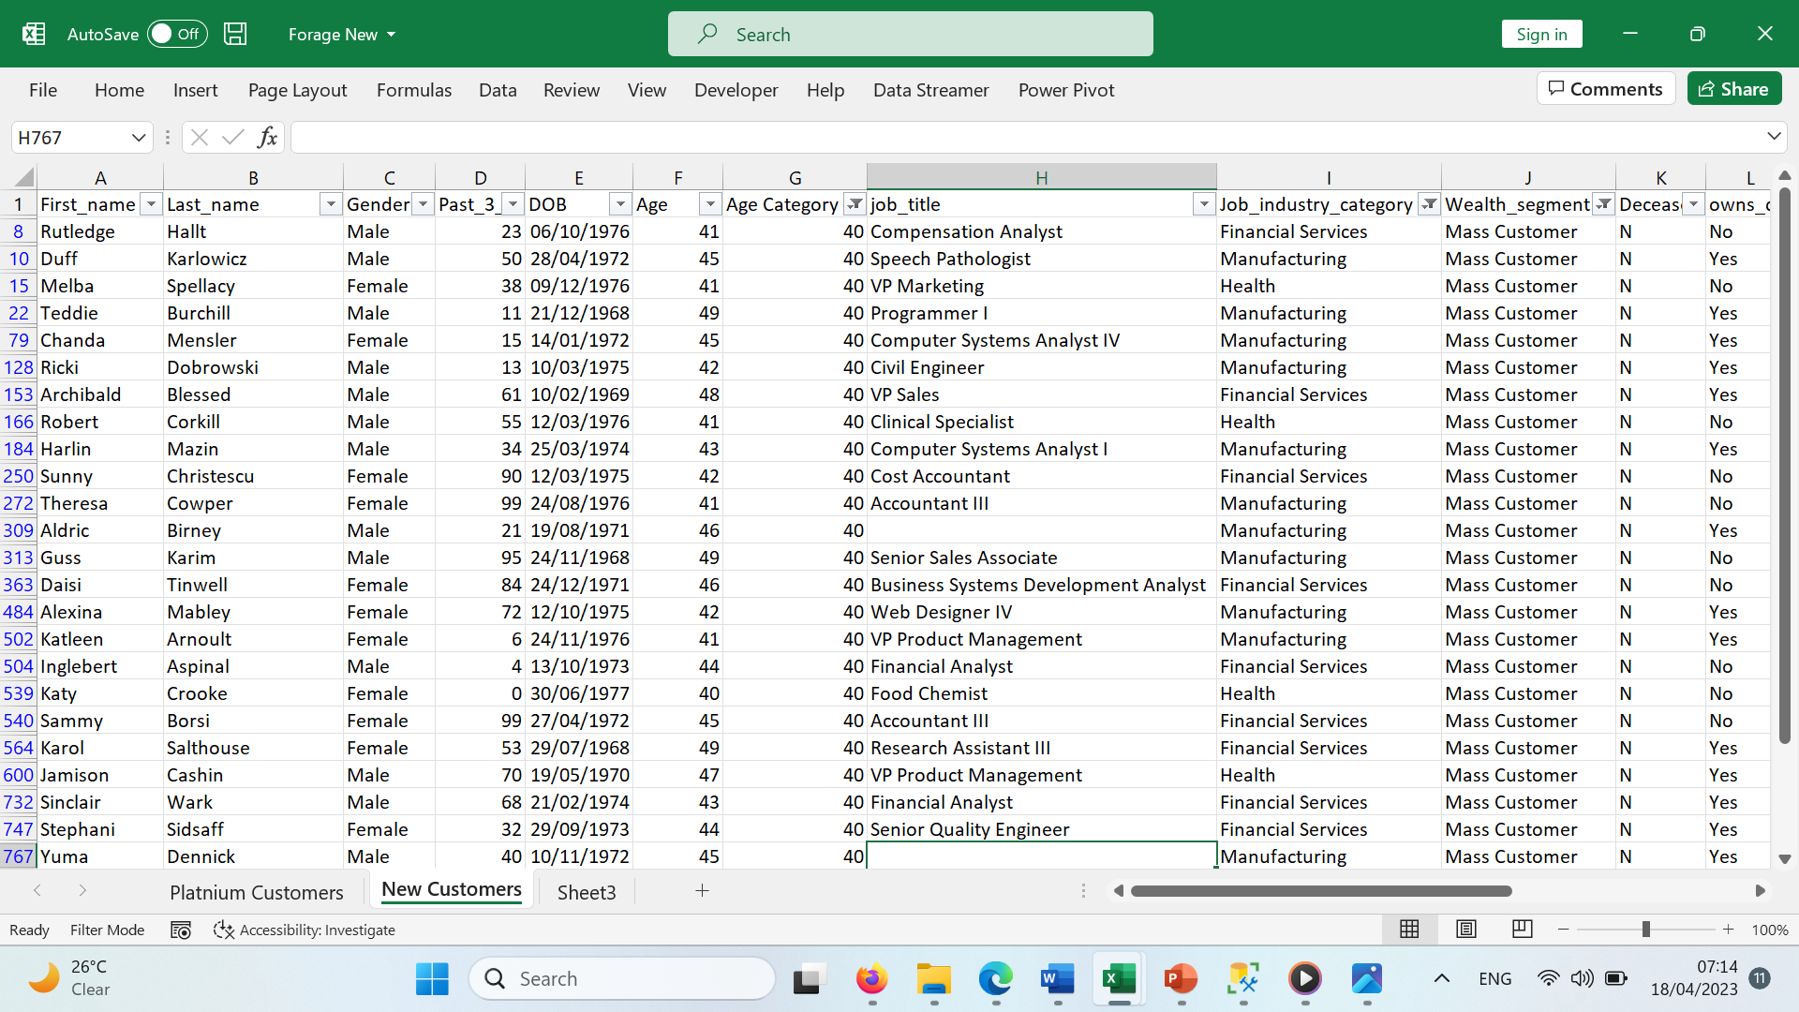
Note: The data and information in this document is reflective of a hypothetical situation and client. This document is to be used for KPMG Virtual Internship purposes only.
Interpretation
New Customers To Target
Customers to target from the 1000 Customers dataset would be:
Mostly in their 40s,
From the Mass Wealth Segment,
Living in New South Wales,
Working in the Financial Services, Health and Manufacturing Industries
And preferably female, however males are almost equally major targets.
Sample of New Customers

Slide 10
Note: The data and information in this document is reflective of a hypothetical situation and client. This document is to be used for KPMG Virtual Internship purposes only.
Sample of New Customers
First_ Name | Last Name | Gender | Past 3 Years bike Related Purchases | DOB | Age | Age Category | Job Title | Job Industry category | Wealth Segment | Owns Car | Address
Rutledge | Hallt | Male | 23 | 06/10/1976 | 41 | 40 | Compensation Analyst | Financial Services | Mass Customer | No | 7 Nevada Crossing
Duff | Karlowicz | Male | 50 | 28/04/1972 | 45 | 40 | Speech Pathologist | Manufacturing | Mass Customer | Yes | 717 West Drive
Melba | Spellacy | Female | 38 | 09/12/1976 | 41 | 40 | VP Marketing | Health | Mass Customer | No | 0591 Anzinger Circle
Teddie | Burchill | Male | 11 | 21/12/1968 | 49 | 40 | Programmer I | Manufacturing | Mass Customer | Yes | 321 Raven Plaza
Chanda | Mensler | Female | 15 | 14/01/1972 | 45 | 40 | Computer Systems Analyst IV | Manufacturing | Mass Customer | Yes | 0 Mockingbird Plaza
Ricki | Dobrowski | Male | 13 | 10/03/1975 | 42 | 40 | Civil Engineer | Manufacturing | Mass Customer | Yes | 8 Eggendart Pass
Archibald | Blessed | Male | 61 | 10/02/1969 | 48 | 40 | VP Sales | Financial Services | Mass Customer | Yes | 7795 Memorial Drive
Robert | Corkill | Male | 55 | 12/03/1976 | 41 | 40 | Clinical Specialist | Health | Mass Customer | No | 5612 Toban Point
Harlin | Mazin | Male | 34 | 25/03/1974 | 43 | 40 | Computer Systems Analyst I | Manufacturing | Mass Customer | Yes | 735 Westridge Road

